Slide 1
Diamond & Associates:
Vision for the Future of Training
Laurel Gilmore
EDU 505 Future of Education
Jennifer Wojcik
February 27, 2014

Slide 2
Description of the Organization
Founded in 1996 with two employees
Currently over 200 employees
Mortgage and Insurance standards
No formal training program until 2011
Reasons for needed training
  Licensing
  Audit requirements
  Client expectations
  Ongoing software changes
Notes:
Hazard claim perils: fire, theft, vandalism, wind, water
Foreclosed and vacant properties
Mortgagees such as Chase, Wells Fargo, Bank of America and Government Sponsored Entities (GSE’s)

Slide 3
Current State of Training
Grow the business
Become profitable
  Ethics
New trainer with skills and knowledge to develop program
Games
Learning styles
Room for growth

Slide 4
Literature Review
Understand different methods of training and development
  Skilled and service jobs
Increased globalization
  Changing demographics
Studies and surveys
  Lack of comprehensive literature
Cross-cultural training
E-learning
  Virtual teams
Technology

Slide 5
Futuring Technique - Scenarios
  Possible futures
  Positive and negative impacts
5 Year future
  Integration with Wingspan
  AR training
  Self-directed training
  Flow Theory

Slide 6
Trends
Increased competition -
Need for skilled workers
Critical thinking/analysis
Technology
Economics
Budgets
Public and Company policy

Slide 7
Challenges
Budgetary
Flexibility
Identify learning styles
Issue identification
Time management

Slide 8
Opportunities
Product knowledge experts – key employees
MOOC’s
Creative growth
Employee growth
Reward for skills and performance

Slide 9
Prepare for the future
Develop scenarios
Determine staffing needs
Develop training modules
Develop assessment tools
Encourage feedback

Slide 10
Call for action
Collaborate with Wingspan
Determine if current training will work for both companies
Develop action plan for merging training
Collaborate via video conference and email

Slide 11
Conclusion
An effective training program will benefit both companies as they move forward separately, but eventually merging. When a company has an effective training program, it will attract desirable employees. Companies that continually improve the skills of existing employees will retain the best ones and develop leadership and diversity.

Slide 12
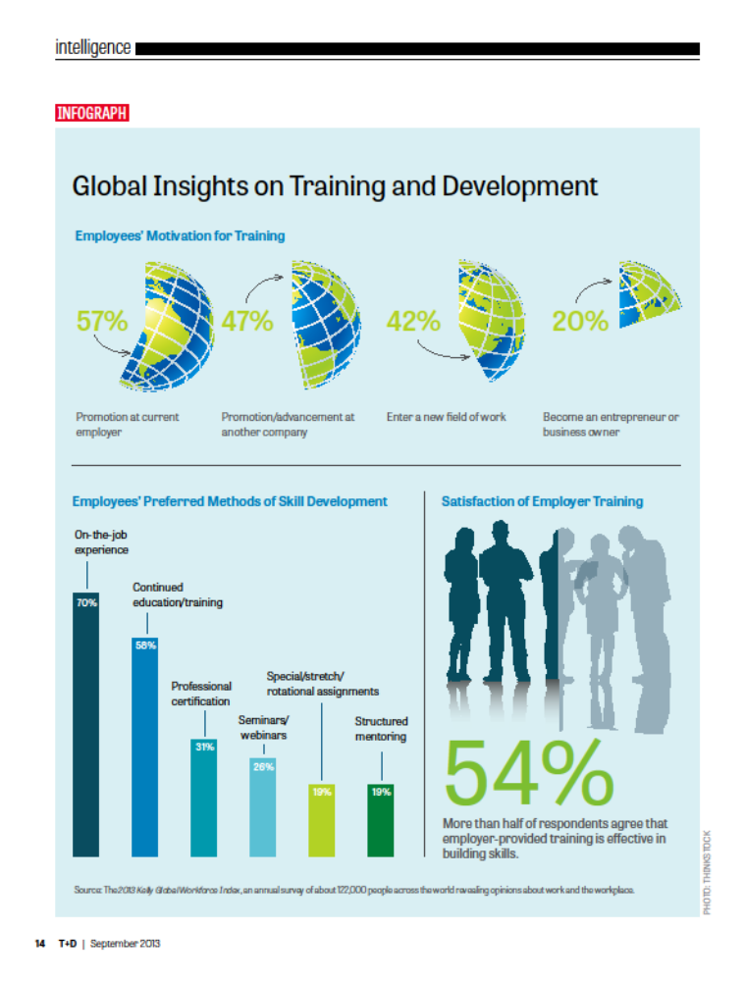

Slide 13
References
Dimont & Associates, A Wingspan Company.
Retrieved from http://www.dimontandassociates.com/index.html
Global Insights on Training and Development. (2013). T+D, 67(9), 14.

